Slide 1
NORDIC CROSS COUNTRY CONFERENCE 2015: REPORT OF LATVIA
prepared with assistance of Janis Puida
MAY 11TH-12TH, OSLO (NOR)

Slide 2
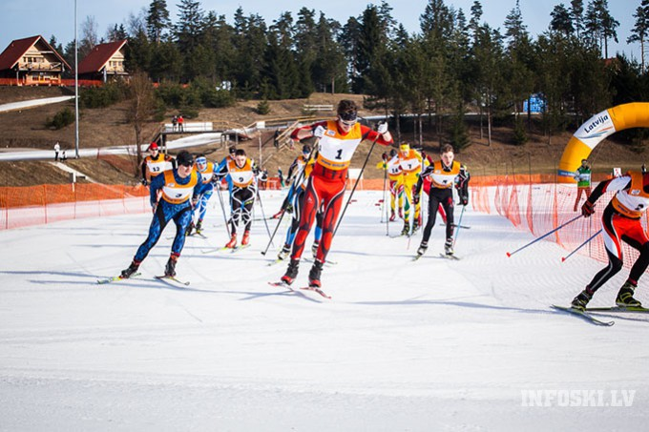
2014/2015 SEASON IN NATIONAL LEVEL
All in all 14/15 was a bit better than 13/14 in terms of natural snow conditions = more people on skies!
More than 50 popular XC races in Latvia ski calendar
3 stages of National Championships:
Priekuli
Vietalva
Madona

Slide 4
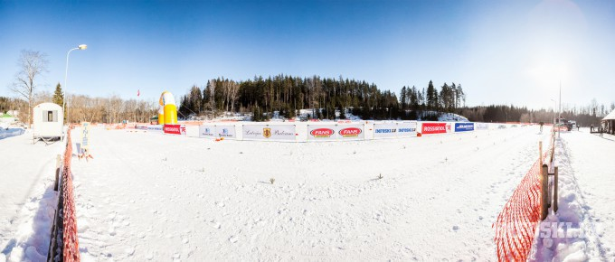
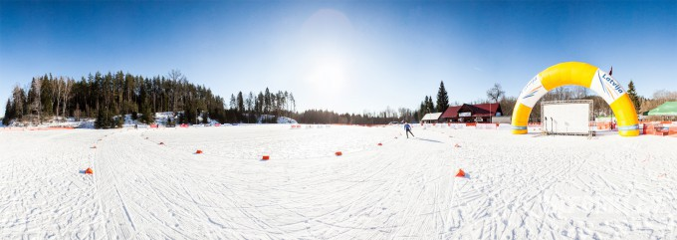
1st time FIS NC in Vietalva homologated courses

Slide 5
NATIONAL TEAM SEASON 2014/2015
NORDIC CROSS COUNTRY CONFERENCE 2015, OSLO
4 Men, 1 Women (at different qualification level)
4 Men, 4 Women at Junior team
WSC in Falun
11 athletes

Slide 6
SCANDINAVIAN CUP
NORDIC CROSS COUNTRY CONFERENCE 2015, OSLO
Lillehammer
No comments
Falun
1 female athlete from Latvia
Madona
Lack of snow in some parts, good organization
Only 3 Latvian athletes in the start list (most of our top athletes are in Falun)
Joulumae
The track was too easy, as it was very fast because of the ice
About 90% chose skating skis for Classic sprint
Otherwise good organized and well prepared track despite the weather
9 Latvian athletes in the start list (could have wished for more)

Slide 7
SEASON 2015/2016
NORDIC CROSS COUNTRY CONFERENCE 2015, OSLO
National Team
Qualification criteria hasn’t been changed
4 Men, 1 Women (at different qualification level)
4 Men, 4 Women at Junior team
the team hasn’t been approved yet
Competitions
World Cup in roller skiing (MADONA, July 24th-26th)
Provisionally 2 stages for NC Rollerskiing
Provisionally 3 stages of Nationals (all in FIS status)

Slide 8
BEHIND THE SCENES
NORDIC CROSS COUNTRY CONFERENCE 2015, OSLO
As the last season was critical :
No coach for National team
National team only on paper, not as united training group
Latvian Biathlon Federation successfully started poaching of skiers
Poor attendance of Latvian athletes on Scandinavian Cup
Changes has to be implemented
Change in board to strenghten CC skiers position and to bring in positive thinking in CC community of Latvia
Optimization of CC calendar
Find a way to secure “our” athletes or cooperate with Latvian Biathlon Federation
Optimize financing of National Team and UNITE them as a Real Team

Slide 9
FOCUS on YOUTH
NORDIC CROSS COUNTRY CONFERENCE 2015, OSLO
New talents on the horizon
Plenty of wins on Swedbank Cup serial in Estonia
Good job with children to improve all-over and skiing performance in Riga, Sigulda, Madona, Cesis, Talsi, etc.
Great performance of several athletes in their mid-teen years
Poor attendance of Latvian athletes on Scandinavian Cup
We have to create long term youth development and support system!

Slide 10
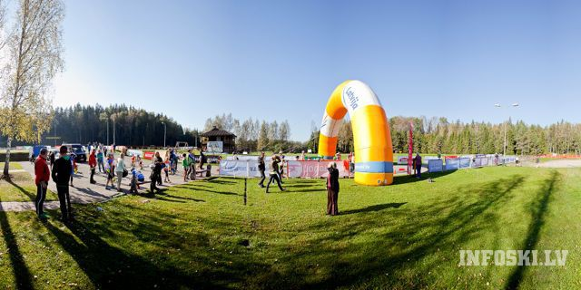
THANK YOU & WISH YOU PRODUCTIVE TRAINNING IN SUMMER!
NORDIC CROSS COUNTRY CONFERENCE 2015, OSLO

