Slide 1
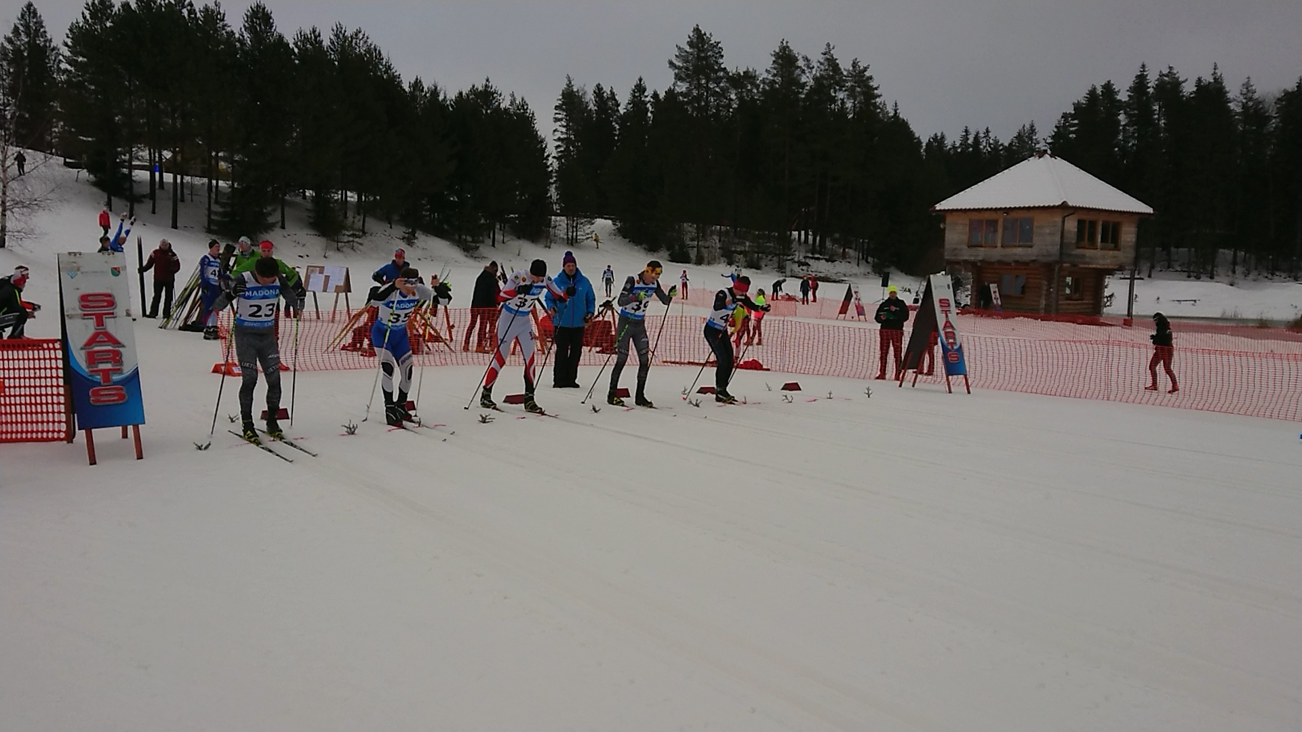
FIS Latvian championship 2019 MADONA, LATVIA 12th-13TH January
TEAM CAPTAIN`S MEETING

Slide 2
FIS Latvian championship 2019 MADONA, LATVIA 12th-13TH January
Agenda
Roll Call
Introduction of the OC and the Jury
Checking the entries
Event Program
Competition course info
Weather Forecast
Information from the TD
Information from the OC
Information from the Equipment Control

Slide 3
FIS Latvian championship 2019 MADONA, LATVIA 12th-13TH January
Roll call
Estonia
Latvia
Lithuania
Mexico

Slide 4
FIS Latvian championship 2019 MADONA, LATVIA 12th-13TH January
Introduction of the the jury
COMPETITION JURY:
FIS TD: Mārtiņš Niklass (LAT) martins.niklass@gmail.com
National TD Assistant: Jānis Puida (LAT) janis.puida@gmail.com
Chief of competition: Gunārs Ikaunieks (LAT) gunars21@inbox.lv

Slide 5
FIS Latvian championship 2019 MADONA, LATVIA 12th-13TH January
Checking entries for the sprint
Start list

Slide 6
Sprint competition program
10:00 | Sprint C qualification Ladies
10:20 | Sprint C qualification Men
11:20 | ¼ finals, ½ finals, finals
12:35 | Official Prize giving ceremony

Slide 7
Latvijas čempionāta programma
līdz 11:45 | Starta numuru saņemšana LČ jauniešu grupām
12:20 | V10,S10 Masu starts klasiskajā solī, dalībnieki tiks sadalīti grupās - 12 dalībnieki 1 startā
13:00 – 13:20 | Iesildīšanās pa sacensību trasi LČ jauniešu grupām
13:30 | Sprinta kvalifikācija S16, V16, S14, V14, S12, V12
14:30 | Sprinta kvalifikācija S12,V12 grupām 2. brauciens
15:00 | LČ Jauniešu grupu S16, V16, S14, V14 – ½fināli, fināli
16:20 | Apbalvošana LČ jauniešu grupām

Slide 8
Sprint competition program
11:20 Sprint ¼ finals
11:20 - 11:45 ¼ finals Men
11:45 Sprint ½ -finals
11:45 - 11:55 ½ finals Ladies
11:55 - 12:10 ½ finals Men
12:10 A finals
12:10 A final Ladies
12:15 A final Men

Slide 9
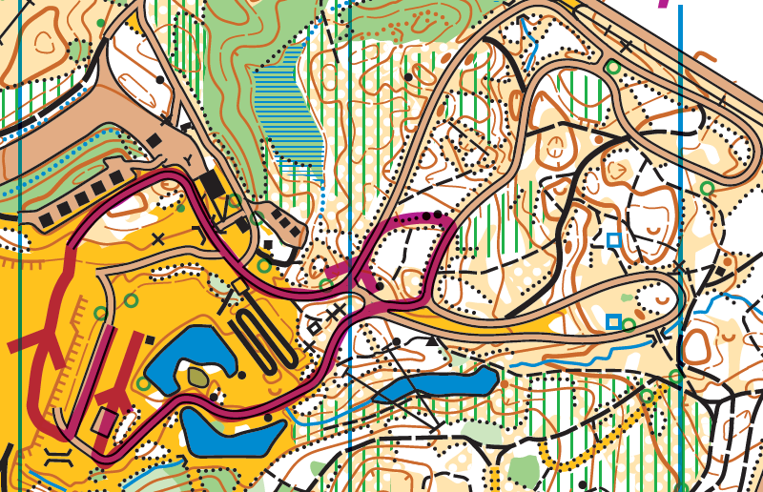
FIS Latvian championship 2019 MADONA, LATVIA 12th-13TH January
Sprint course layout Ladies 1,1 km

Slide 10
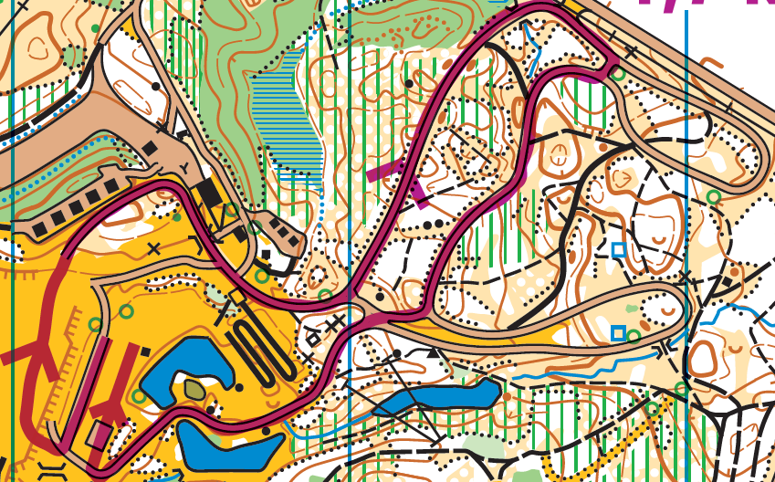
FIS Latvian championship 2019 MADONA, LATVIA 12th-13TH January
Sprint course layout men 1,7 km

Slide 11
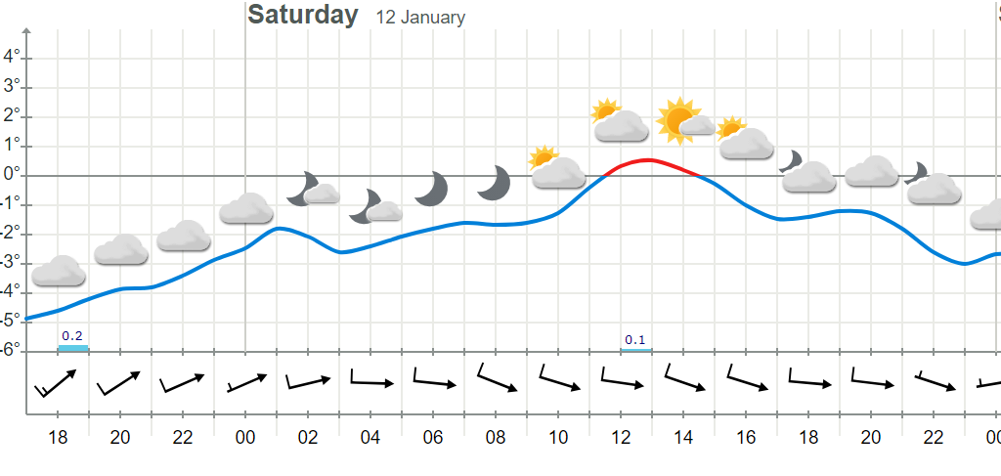
FIS Latvian championship 2019 MADONA, LATVIA 12th-13TH January
Weather forecast

Slide 12
FIS Latvian championship 2019 MADONA, LATVIA 12th-13TH January
Useful information
www.smeceressils.lv

Slide 13
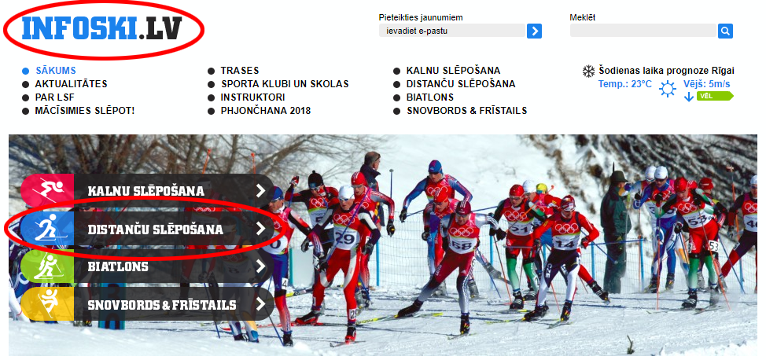
FIS Latvian championship 2019 MADONA, LATVIA 12th-13TH January
Useful information

Slide 14
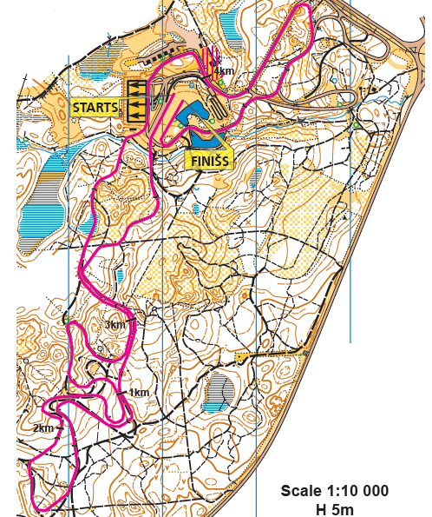
Interval start (F) Sunday 13th january

Slide 15
FIS Latvian championship 2019 MADONA, LATVIA 12th-13TH January
Information from fis td

Slide 16
FIS Latvian championship 2019 MADONA, LATVIA 12th-13TH January
Written reprimanded
+ = DSQ
Up to this date (12.01.2019.) none of entered athletes has written reprimand

Slide 17
FIS Latvian championship 2019 MADONA, LATVIA 12th-13TH January
Information from the equipment control
343.8.1
In classical technique competitions, the maximum pole length must not exceed 83% of the competitor’s body height. …
The body height is measured with ski boots on from a flat surface, to the top of the uncovered head.
The pole length is measured from the bottom of the pole to the highest attachment of the strap.
All measurements will be rounded to the nearest centimeter as follows: less than 0.5 cm will be rounded down and 0.5 cm and above will be rounded up.

Slide 18
FIS Latvian championship 2019 MADONA, LATVIA 12th-13TH January
Information from organizer

